Slide 1


Project 3 Deployment Architecture
A full-stack, highly available 3-tier AWS deployment featuring Nginx, Dual EC2 Frontends, Node.js Backend, Application Load Balancer, and Amazon RDS MySQL.

Slide 2
System Architecture Overview
Comprehensive breakdown of the multi-tier networking, load balancing, compute instances, and database connectivity.

Slide 3


3-Tier Cloud Architecture
Public Presentation Tier
Private Application & Data Tier
Load Balancer: AWS Application Load Balancer listening on Port 80 distributing traffic equally (50/50 ratio) across public targets.
Backend API: Node.js application server (server.js) running isolated in a private subnet on Port 3000 with NAT Gateway egress access.
Web Servers: Two distinct EC2 frontend instances deployed across Availability Zones (us-east-1a and us-east-1b) hosting HTML/CSS assets with Nginx.
Database Tier: Amazon RDS MySQL database instance (database-1) listening on Port 3306 with restricted VPC Security Group access.

Slide 4
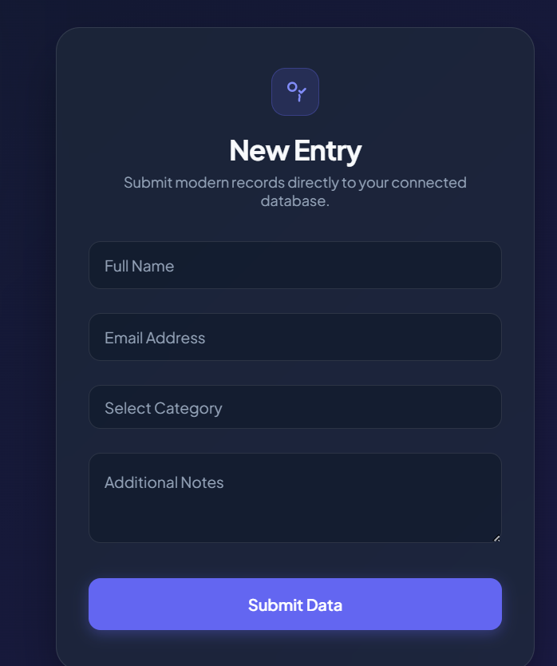


Frontend Web Interface & Forms
User Interface Layer
The web frontend is composed of responsive HTML5 and CSS templates providing an intuitive user form for submitting records directly into the connected database.
•
Static Files: HTML/CSS files hosted via Nginx web server.
•
Form Inputs: Full Name, Email Address, Category selection, and Notes.
•
Asynchronous Requests: Submits RESTful JSON payloads to backend API.
•
Reverse Proxy: Nginx proxies incoming Port 80 web requests seamlessly.

Slide 5
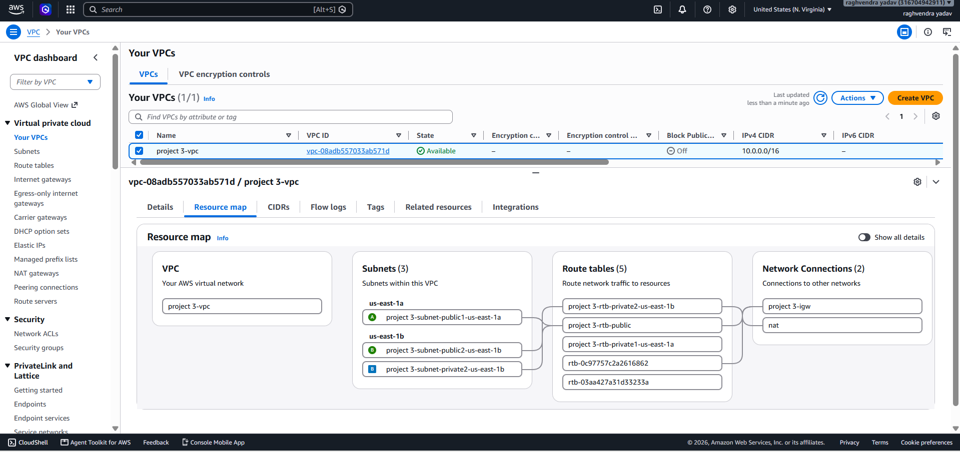
VPC & Subnet Network Mapping
Isolated AWS Network Topology
Custom Virtual Private Cloud (project 3-vpc) created with a CIDR block of 10.0.0.0/16 ensuring secure multi-AZ network segregation.
•
Public Subnets: public1-us-east-1a and public2-us-east-1b connected to Internet Gateway (project 3-igw).
•
Private Subnets: private2-us-east-1b isolated from direct public ingress, utilizing NAT Gateway for outbound updates.
•
Route Tables: Dedicated public and private route tables managing traffic flow.

Slide 6
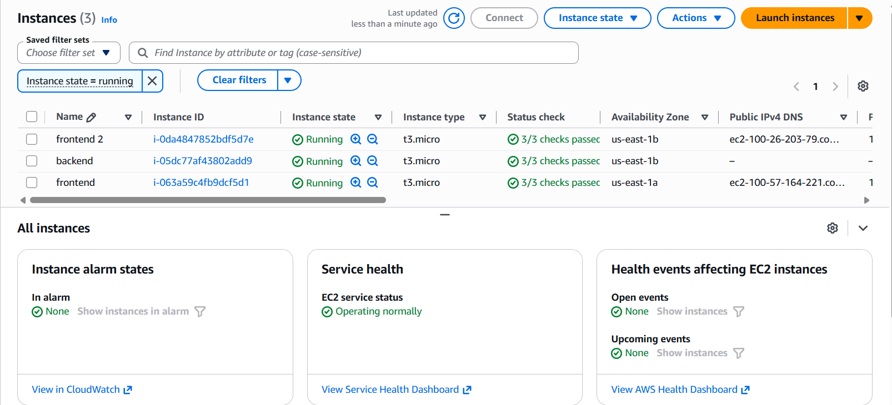
EC2 Instances & Availability
Compute Nodes Provisioning
Three t3.micro EC2 virtual machines deployed across multiple Availability Zones to achieve high availability and fault tolerance.
•
frontend (i-063a59c4fb9dcf5d1): Public subnet in us-east-1a running Nginx.
•
frontend 2 (i-0da4847852bdf5d7e): Public subnet in us-east-1b running Nginx.
•
backend (i-05dc77af43802add9): Private subnet in us-east-1b running Node.js server.js.

Slide 7
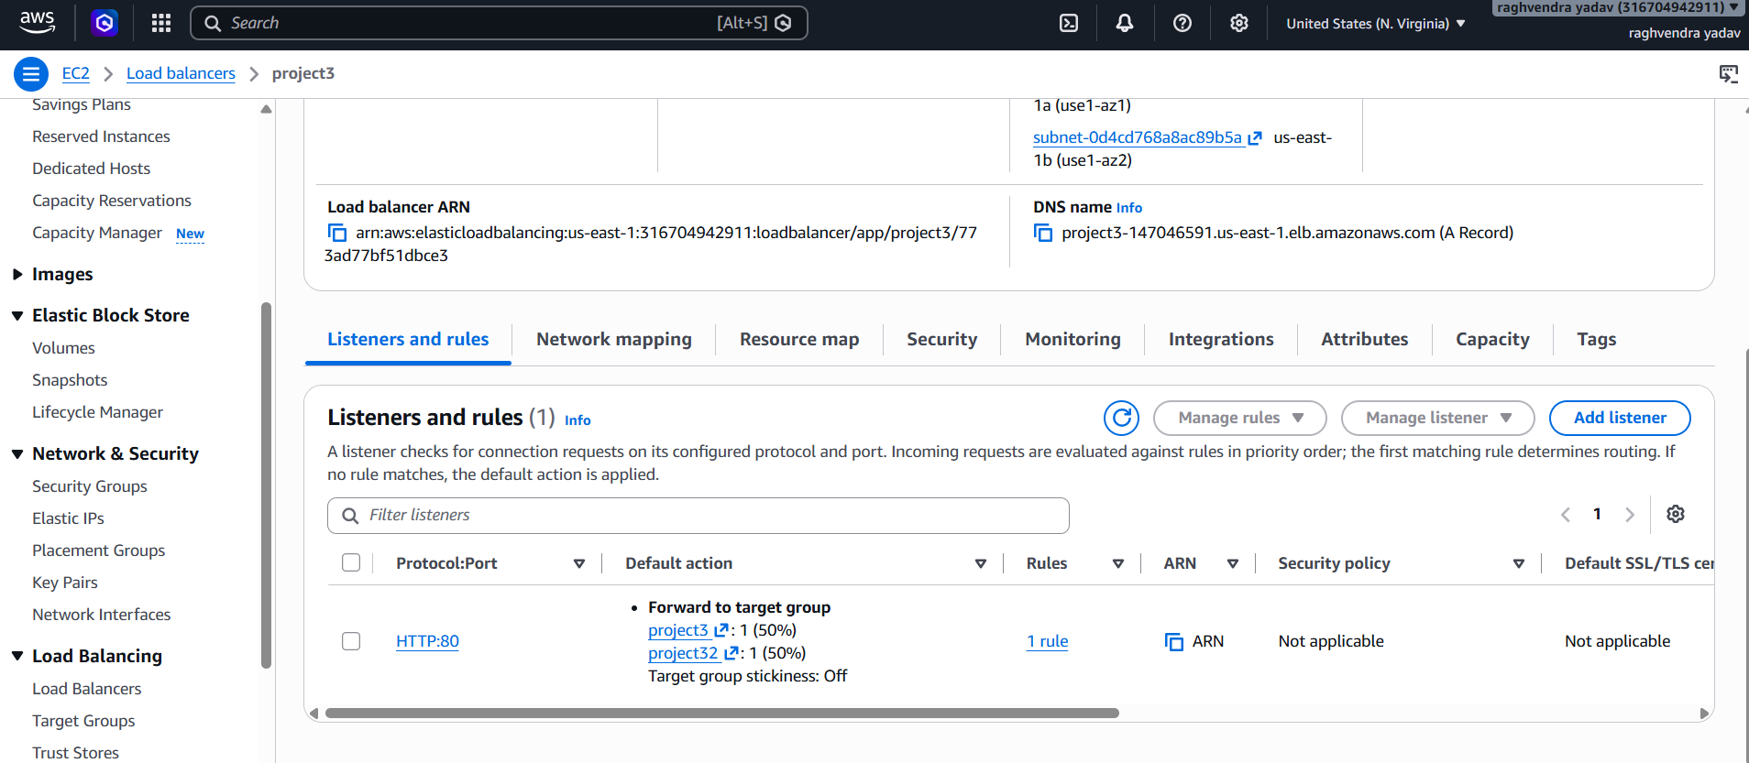
Application Load Balancer Setup
Traffic Distribution & Routing
AWS ALB (project3) routes user traffic evenly across both frontend nodes to guarantee zero downtime and balanced server loads.
•
ALB DNS Endpoint: project3-147046591.us-east-1.elb.amazonaws.com
•
HTTP Rule (Port 80): Listens for incoming public HTTP requests.
•
Target Group Weighted Routing: 50% traffic forwarded to project3 target group and 50% to project32 target group.

Slide 8
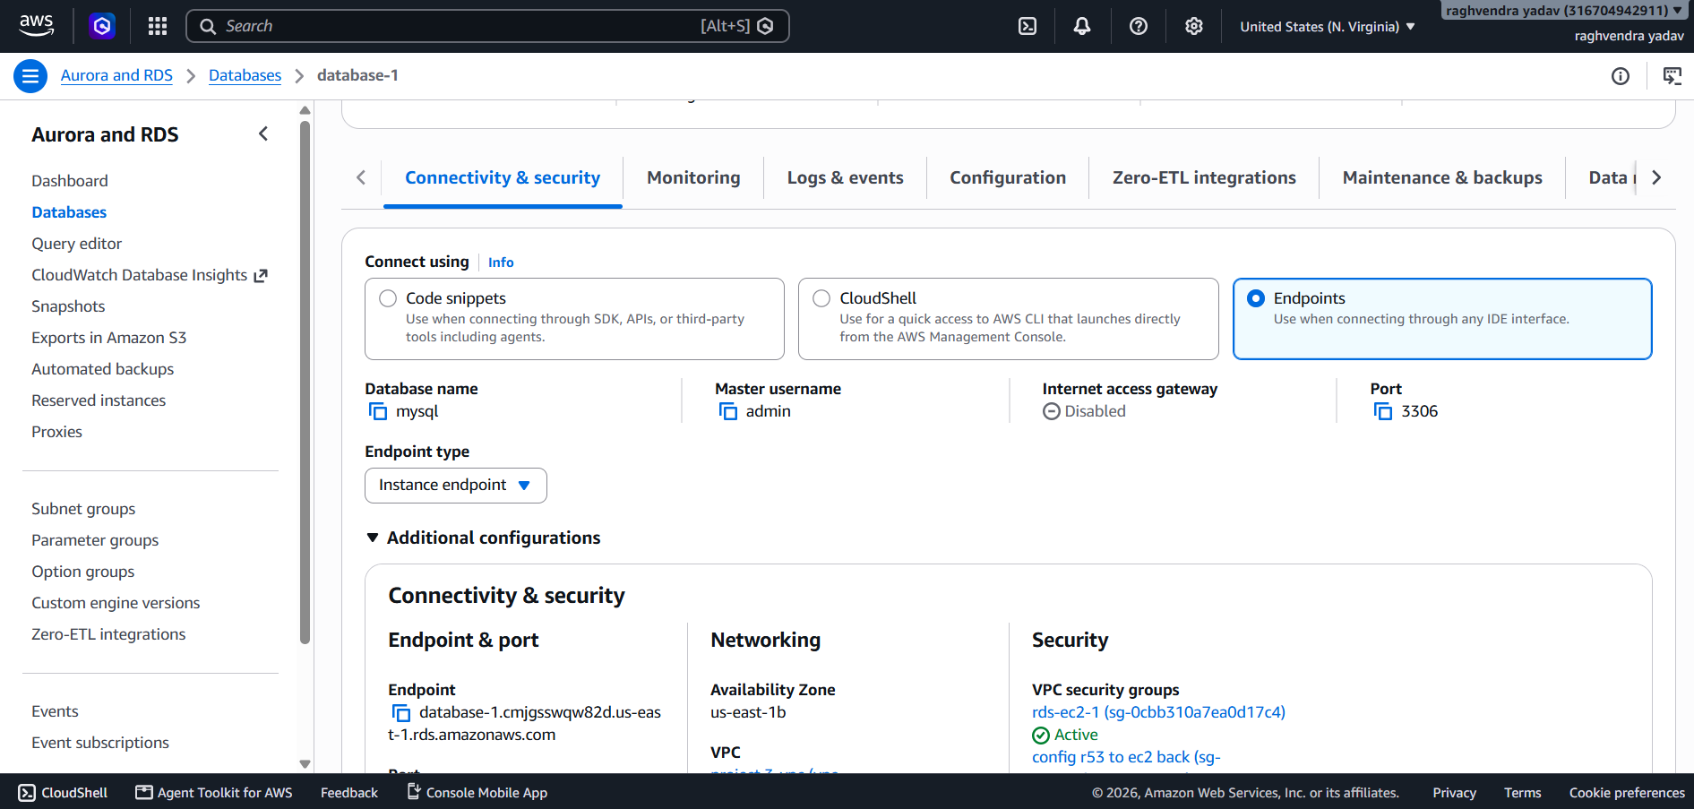
Backend Server & RDS MySQL DB
Database Engine & Backend Connection
Amazon RDS MySQL instance (database-1) configured as the centralized relational data persistence layer for backend transactions.
•
Endpoint: database-1.cmjgsswqw82d.us-east-1.rds.amazonaws.com
•
Configuration: MySQL engine running on standard Port 3306 with admin master user.
•
Network Isolation: Internet Access Gateway Disabled; accessible exclusively from backend security group rds-ec2-1.

Slide 9
Security & Network Isolation
VPC Security Groups: Configured granular inbound rules allowing ALB to Frontend (Port 80), Frontend Nginx to Backend (Port 3000), and Backend to RDS (Port 3306).
Private Subnet Isolation: The backend Node.js server and Amazon RDS instance operate inside private subnets without public IPv4 addresses.
NAT Gateway Egress: Enables private backend instances to pull updates and packages securely from the internet without exposing inbound access.
Nginx Reverse Proxy: Hides underlying Node.js application server signature and manages client connection forwarding efficiently.

Slide 10




Deployment Workflow & Git Pipeline
4. ALB & Route 53
2. Provision AWS Infra
Attach target groups to Load Balancer, test 50/50 traffic routing, and verify end-to-end RDS submission.
Create VPC, public/private subnets, Internet Gateway, NAT Gateway, Security Groups, and RDS database.
Local source
3. Deploy EC2 & Nginx
Code resource (uploaded from local device )
Uploaded on EC2 instances, configure Nginx reverse proxy on port 3000, and launch Node.js service.

Slide 11
Questions & Discussion
Project 3 AWS Infrastructure Deployment Complete & Ready for Review.

